Slide 1
Visualize thread pool tool for Spring web application
Team B

Slide 2

Contents
01
02
03
04
Motivation
Design & Impl
Challenges
Limitations & eval

Slide 3

Part 1
Motivation
ⓒSaebyeol Yu. Saebyeol’s PowerPoint

Slide 4

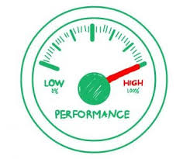
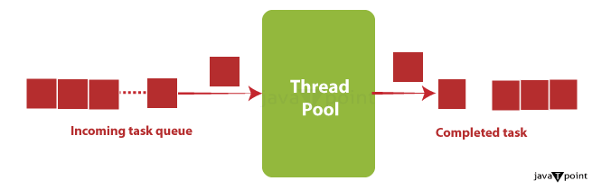

{ }
Motivation
Tool Problem
Threadpool Visualization
Expected Effect
Notes:
그라파나와 그라파이트는 전체적인 메모리 사용량 추이, 트래픽의 추이는 알 수 있지만, 개별 API에 대한 정보는 시각화 하지 않음. 개발자에게 API 에러가 있거나 성능 저하를 일으키는 API를 찾아낼 수 있는 시각화 도구 필요함. 기대효과는 개발자가 설계한 프로그램의 실행 속도 상승, 메모리 사용량 줄임.
Graphana and Graphite can see overall memory usage trends and traffic trends, but do not visualize information about individual APIs. Developers need a tool that can find APIs that degrade performance or memory usage. Expected effects are increased execution speed of programs designed by developers and reduced memory usage.

Slide 5
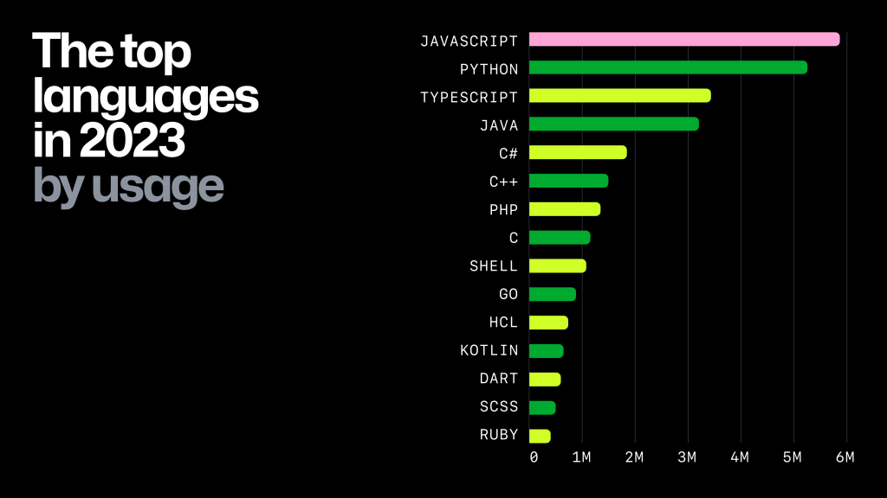
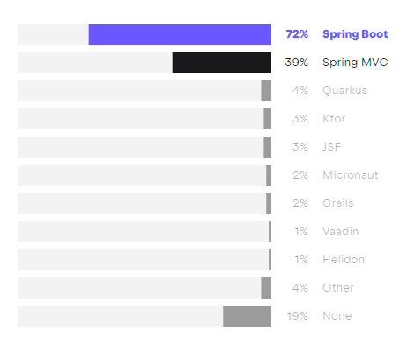
Part 1 >>
Objective
Spring boot program
popularity
Among the languages, Java is used a lot, and among Java, Spring Boot is used a lot.
Visualization
web
service
filtering
Use the web to display API information.
category
It is easy to obtain the desired API information.
Notes:
Our Threadpool visualization program focused on popularity, web service, and classification. First, Java language is the most used language among programming languages, and Spring Boot is also the most used tool for web development in Java language. Second, we want to develop a web service that visualizes API information for this Spring Boot project. Third, when visualizing API information, we classify and sort it so that developers can obtain the API information they want.
저희 Threadpool visualization 프로그램은 대중성, 웹서비스, 분류화 3가지에 초점을 두었습니다. 첫째, 자바 언어는 프로그래밍 언어 중 가장 많이 사용되는 언어이고, 자바 언어에서도 스프링 부트가 웹 개발에 가장 많이 사용되는 도구입니다. 둘째, 저희는 이 스프링 부트 프로젝트를 대상으로 API 정보를 시각화하는 웹 서비스를 개발하고자 합니다. 셋째, API 정보를 시각화할 때 개발자가 원하는 API 정보를 얻을 수 있게 분류하고 정렬합니다.

Slide 6
Part 1 >>
Members’ role
Testing
Implement Frontend
Implement Library
Background Study
Backend Developer
UI/UX design (Figma)
Project Deployment
Background Study
한용준
김준영
Implement Frontend
Design Implement
Background Study
김경현
윤재환
Implement Frontend
Design Implement
Library Deployment
Background Study
Notes:
The roles are as follows.

Slide 7
Part 1 >>
Project Processing
week
2~3
week
4~5
week 6~7
Problem Definition
Background Study
Impl Custom Library
week 8~11
week
12
week
13~15
Develop web app
UI / UX
deploy/test
Notes:
처음 2주 동안에는 시각화 프로그램의 동기와 목표를 세웠습니다. 다음 2주에는 저희는 개발 툴을 공부하였습니다. 6주차부터는 시각화를 할 스프링 부트 커스텀 라이브러리를 개발하였습니다. 8주차부터는 본격적으로 시각화 프로그램을 개발하였고 12주차부터는 UI을 설계하였습니다. 그리고 현재 배포 및 테스트 중에 있습니다.
In the first two weeks, we set the motivation and goal of the visualization program. In the next two weeks, we studied the development tool. From the 6th week, we developed the Spring Boot Custom Library for visualization. From the 8th week, we developed the visualization program in earnest, and from the 12th week, we designed the UI. And it's currently being deployed and tested.

Slide 8

Part 2
Design & Implementation
ⓒSaebyeol Yu. Saebyeol’s PowerPoint

Slide 9

Final Design

Slide 10
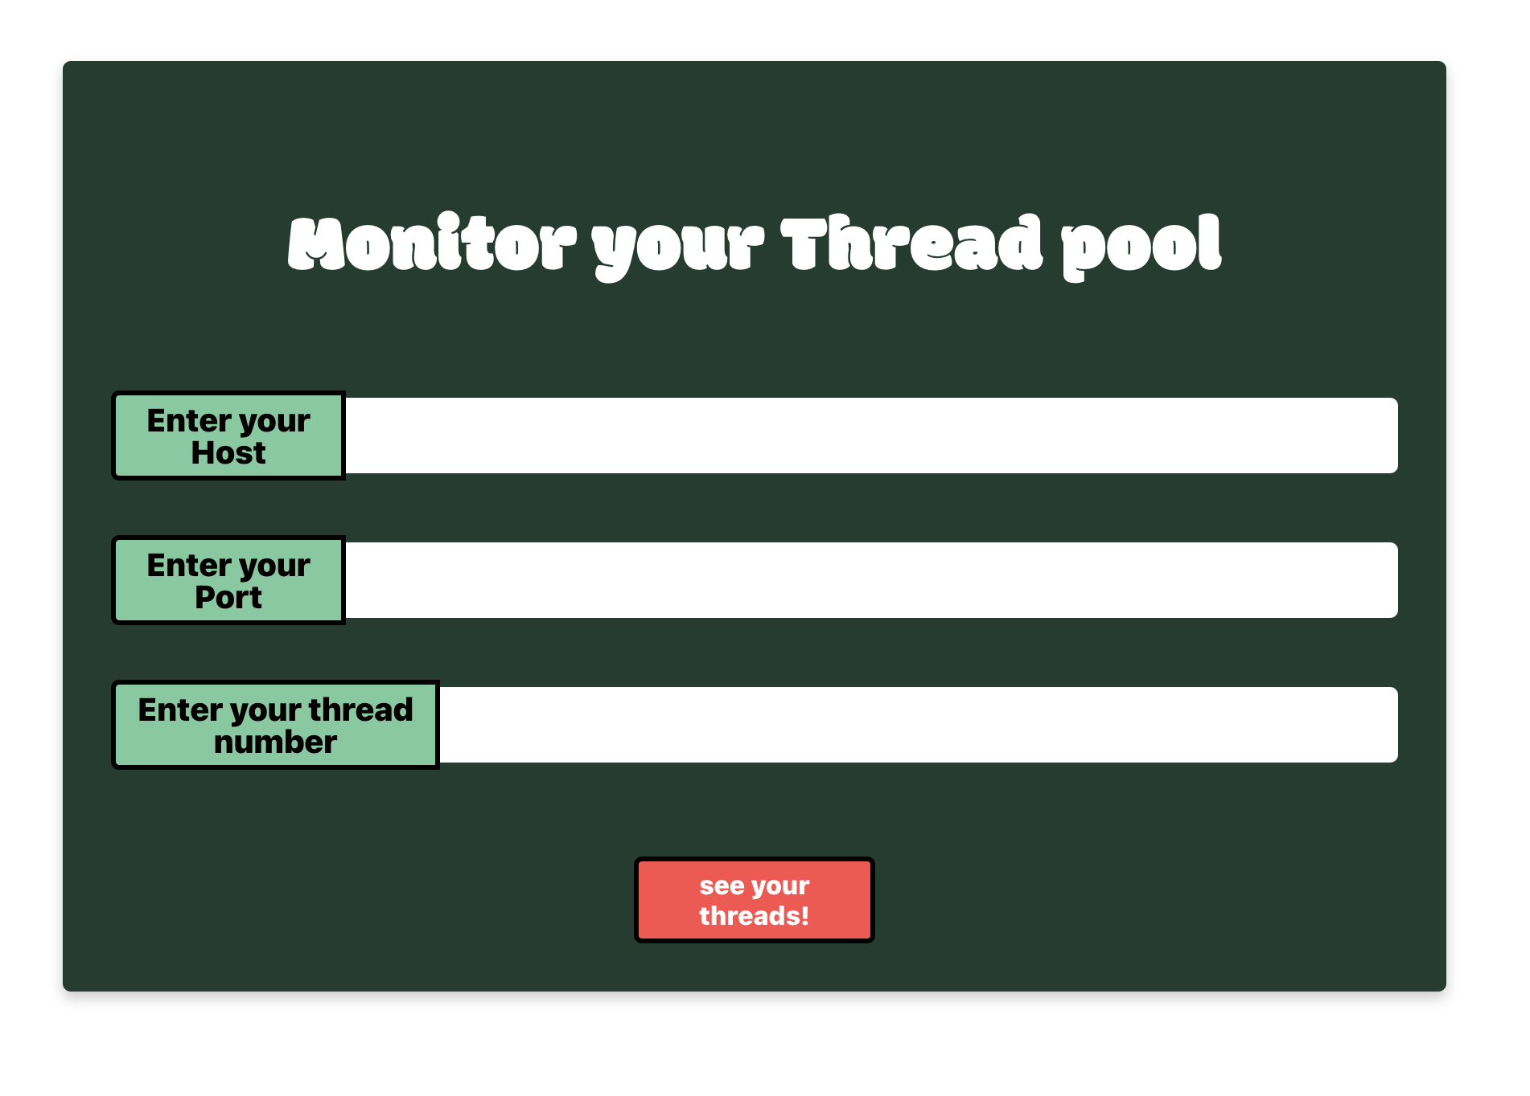

Slide 11
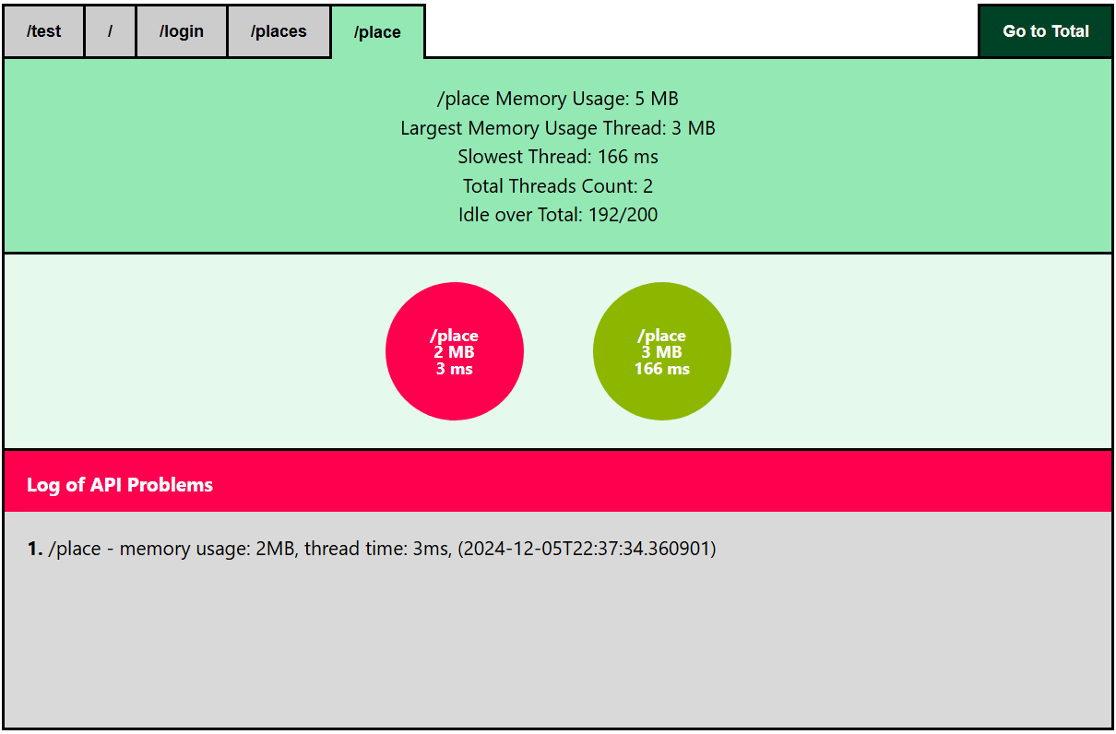
Notes:
This is the page to checkout detailed information of the thread and api per category.
On the top, we can switch between categories cut between the leading slash and the upcoming slash.
On click, total memory usage, largest memory usage thread, slowest thread, and total active threads of the category are given. Idle thread count is also displayed beneath all information.
In the middle, we have threads in bubbles. Red indicates erroneous bubble and green indicates a well running thread.
At the bottom, list of erroneous logs are shown with detailed information.
We can click the button on the top right corner to direct to the total page.

Slide 12
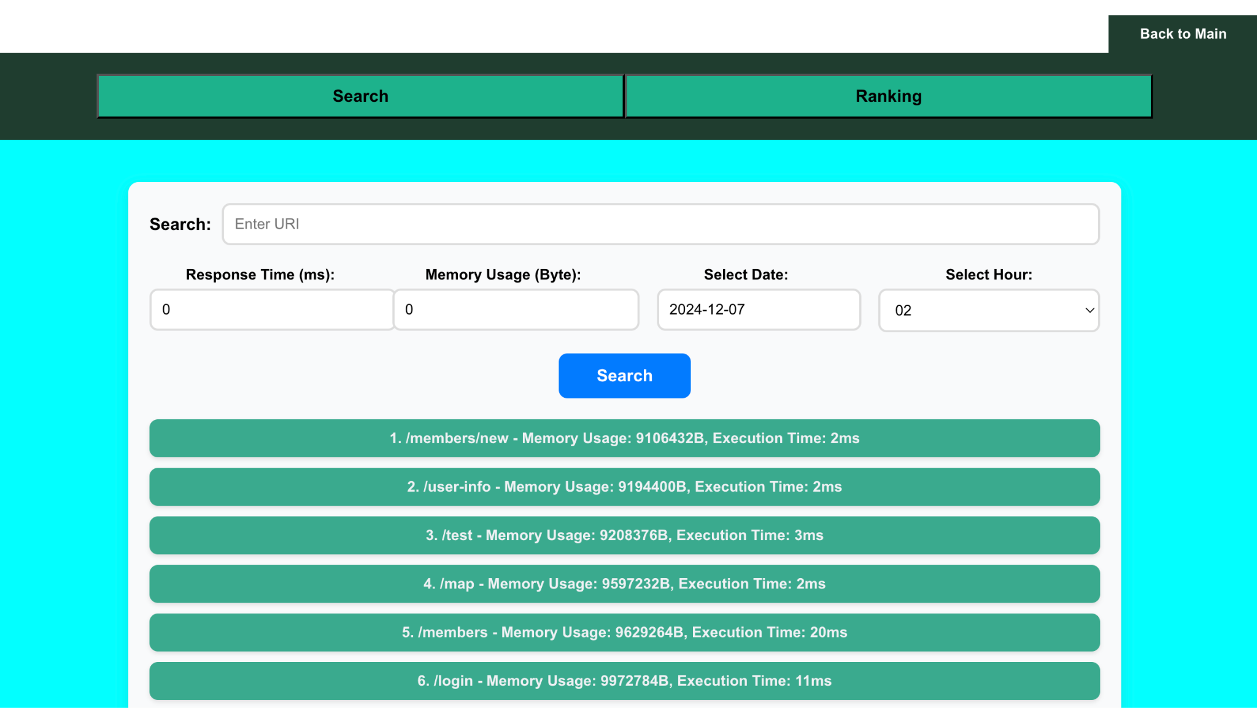
Notes:
Next is the Summary Page.
First, we have the Search Page.
Users can set minimum thresholds for response time and memory usage, along with a specific date and hour.
The system retrieves and displays data for all URIs within the selected one-hour range, showing their memory usage and execution time.
To search for data related to a specific URI, users can enter the URI in the Search field and click the Search button for detailed results.

Slide 13
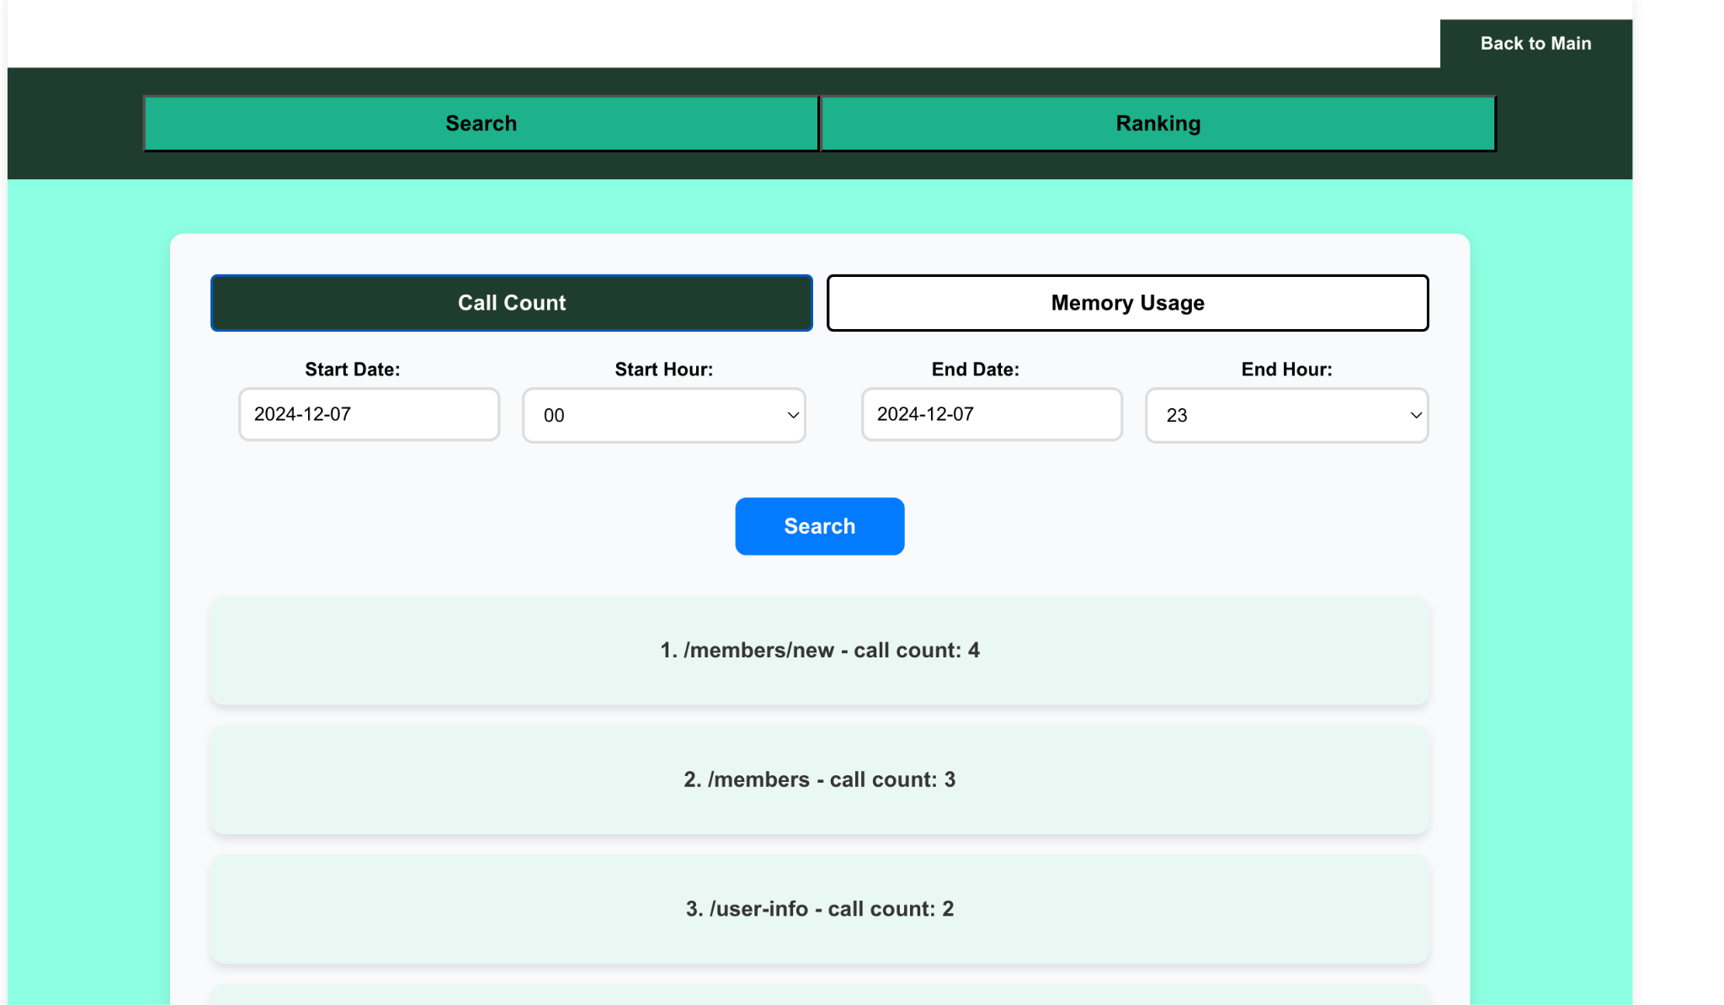
Notes:
Next is the Ranking Page.
First, the Call Count Page.
Users can specify a date range and time period to view call count rankings.
By clicking the Search button, the system retrieves and displays rankings, enabling precise and flexible analysis of call count data.

Slide 14
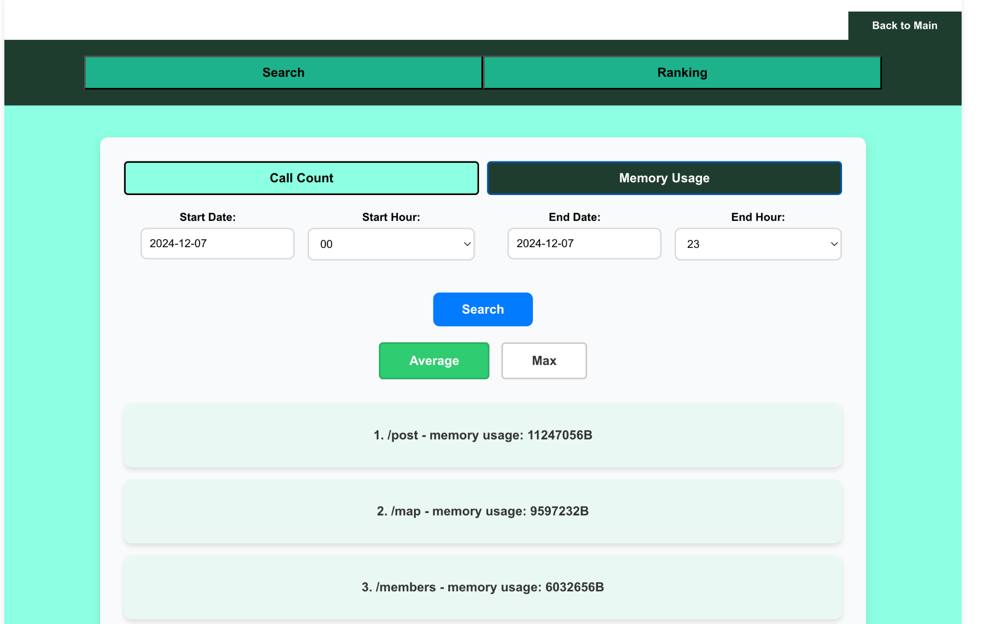
Notes:
Finally, this is the Memory Usage Page.
Users can specify a time range to view memory usage rankings.
By selecting Average, the page shows the average memory usage for the period. Selecting Max displays the maximum memory usage.
The results highlight memory usage for each URI, helping users identify resource-intensive URIs and optimize system performance.

Slide 15

Implementation
ⓒSaebyeol Yu. Saebyeol’s PowerPoint

Slide 16
{ }
Overall architecture
user’s application
our tool
sdsd
Spring application
our library
Backend
Frontend
Notes:
This is how our tool works. For user, to use this tool for his Spring Project, he needs to use our custom library ; which collect data of each thread and load to endpoint. our Backend gets data and send to frontend and frontend focused on interacting with users.

Slide 17
Part 2 >>
Library
Library
Role : collect user’s Spring project’s data about each thread

Slide 18
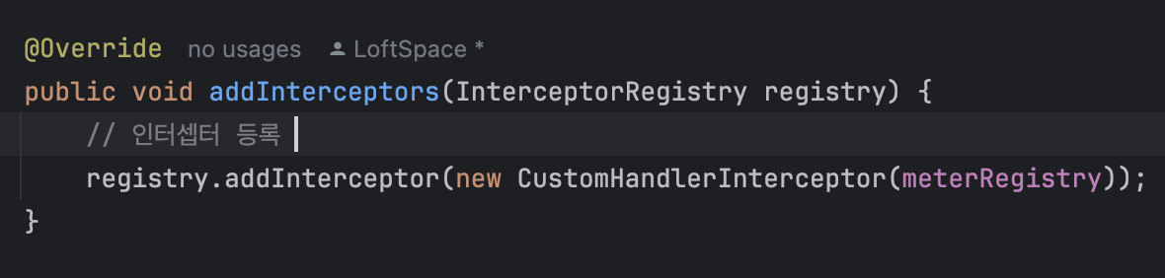
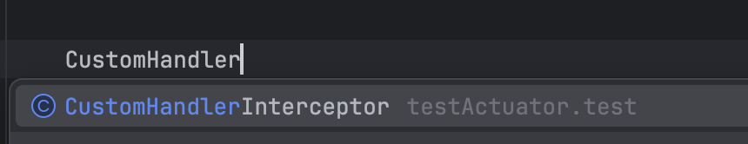
Part 2 >>
Library
Expected : can download and import our custom handler interceptor library
Notes:
what we expect here is that user can download library and import our custom library.

Slide 19
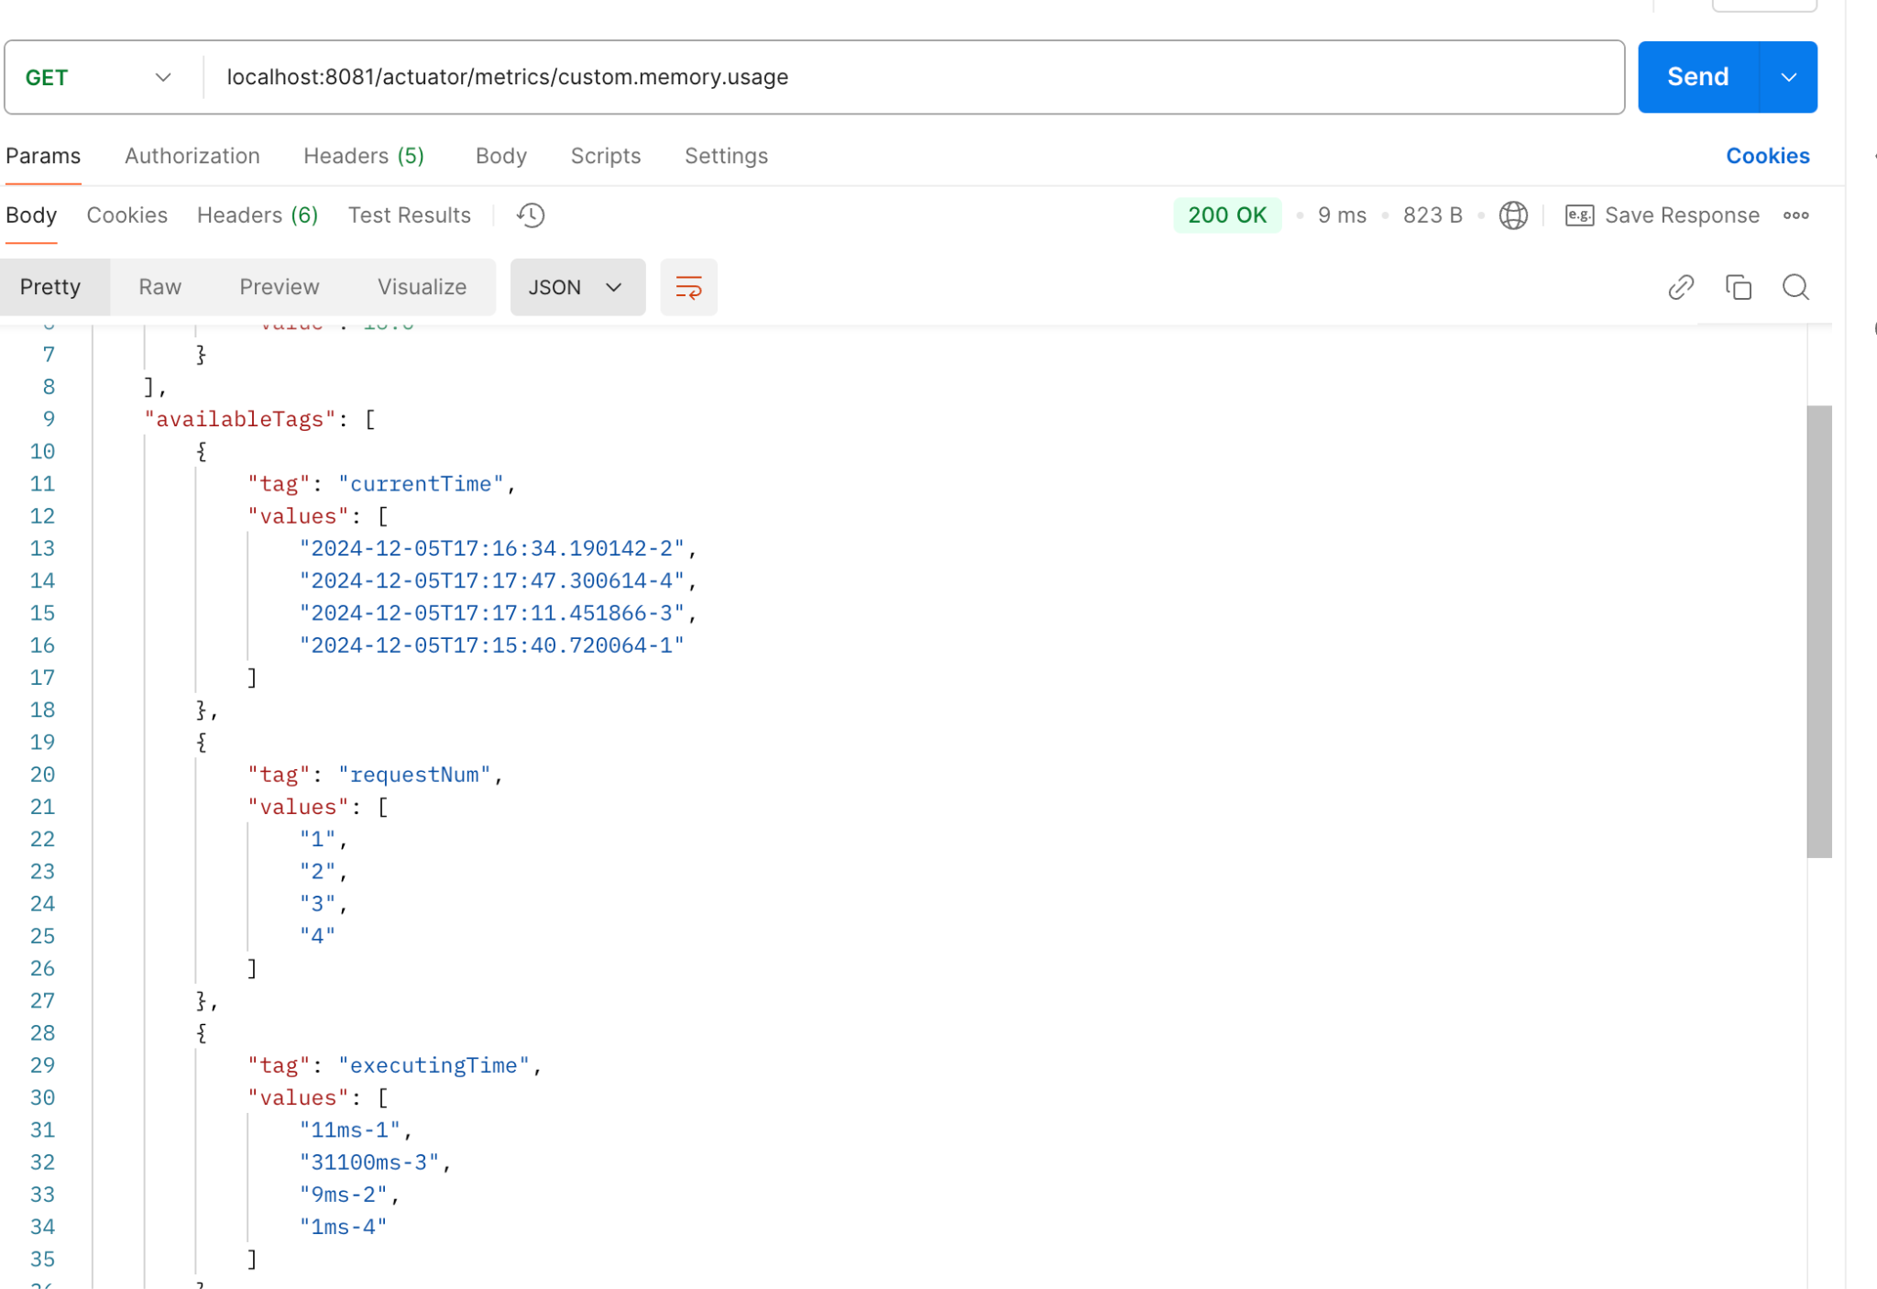
Part 2 >>
Library
Expected : our library is working well.
Situation : user is running his spring app and using our library
can see our library is showing information about each thread
Notes:
We can see the data is loaded on actuator well by using postman tool.

Slide 20
Part 2 >>
Backend

Slide 21
Part 2 >>
What does our backend do?
Spring application
actuator
Backend
actuator API information
Filtering, Transferring Data
Notes:
When API information is sent from the spring actuator, the data is transferred from the back end to the front end through filtering.
스프링 액추에이터에서 API 정보를 보내면 백엔드에서 필터링을 거쳐 프론트엔드로 데이터를 전달한다.

Slide 22
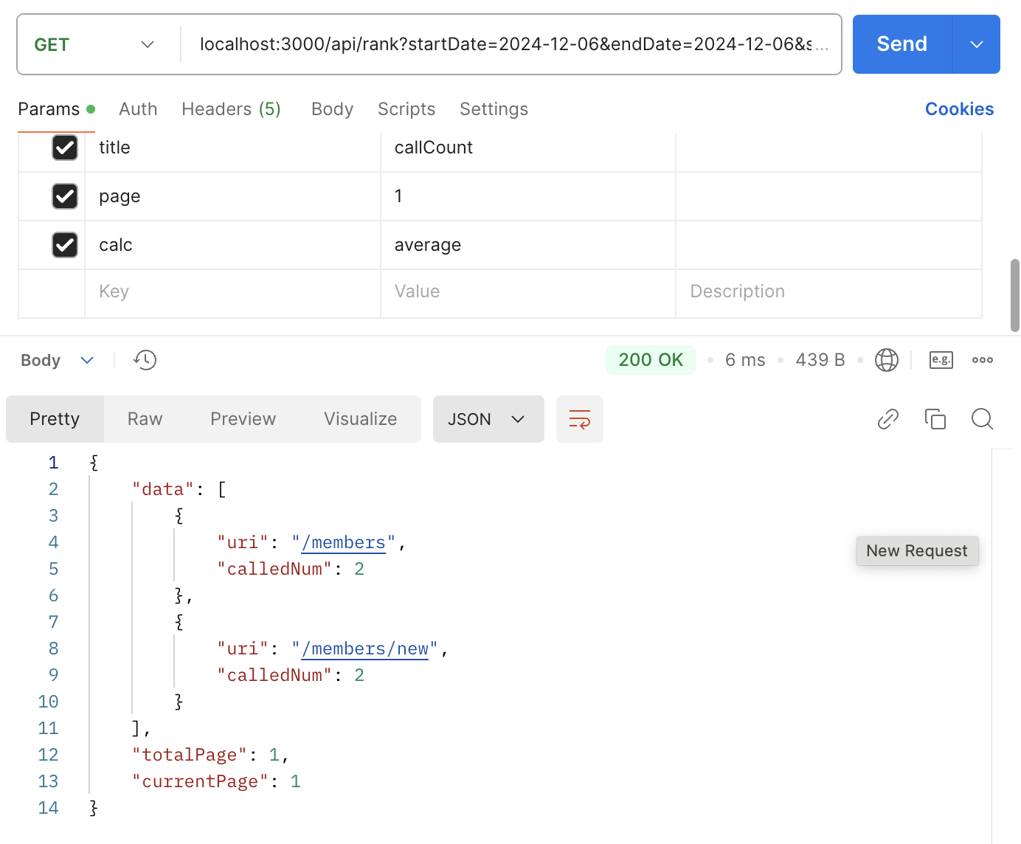
Part 2 >>
What does our backend do?
find ranking list by number of API called in 2024-12-06
Expected data
(for ranking)
Result
Notes:
For example, on December 6, 2024, when a request to find a ranking table by API number is sent to the backend, the API data obtained from the actuator is filtered and returned.
예를 들어, 2024년 12월 6일 API 수로 순위표를 찾는 요청을 백엔드로 보내면 이에 해당하는 것을 액추에이터에서 얻은 API 데이터들을 필터링을 거쳐 반환한다.

Slide 23
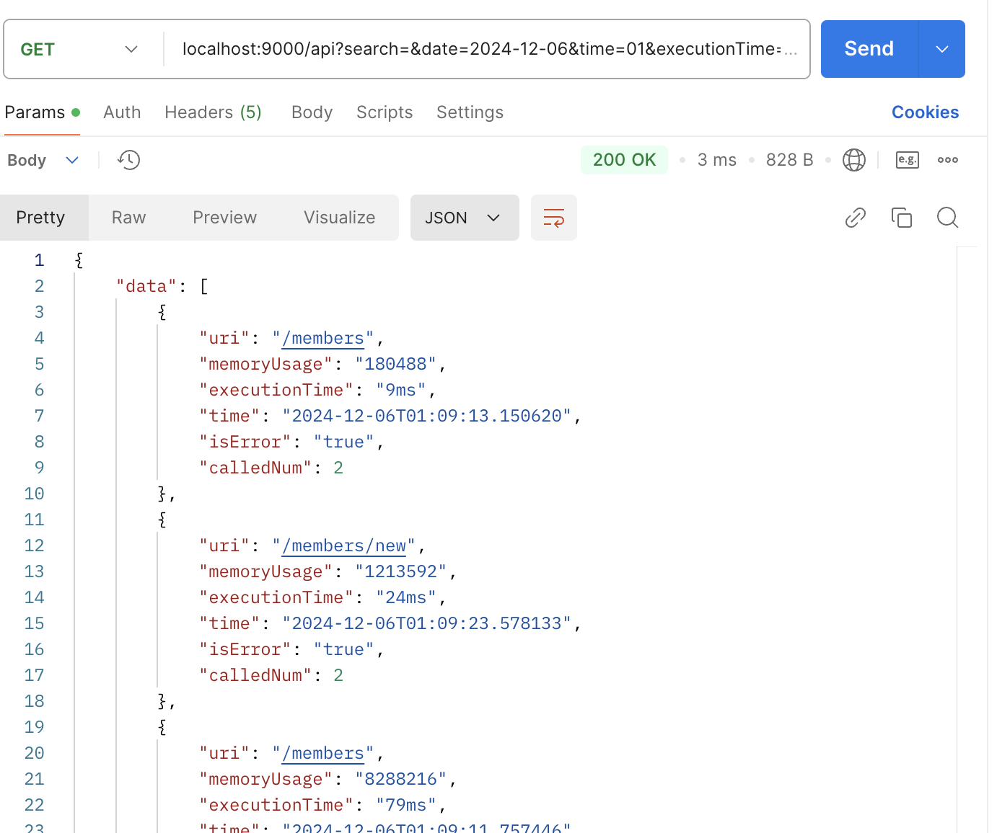
Part 2 >>
What does our backend do?
find data in 2024-12-06, which used more than 0 byte of memory, longer than 0ms execution time
Expected data
(for searching service)
Result
Notes:
As another example, on December 6, 2024, a request to find API data with a run time longer than 0ms, which is more than 0 bytes of memory, is sent to the backend and the API data obtained from the actuator is filtered.
또 다른 예를 들면, 2024년 12월 6일에 메모리 0바이트보다 많이 사용한, 실행 시간이 0ms보다 긴 API 데이터를 찾는 요청을 백엔드로 보내면 이에 해당하는 것을 액추에이터에서 얻은 API 데이터들을 필터링을 거쳐 반환한다.

Slide 24
Part 3 >>
Backend - File Storage
user’s project
Actuator endpoint
Our tool
Backend
Frontend
request 50
request 51
request 52
sort data
filter data
ranking service
search(or filter) service
save as file
request 60
Notes:
The actuator's data is initialized every 5 seconds, so there is no data left in the actuator. Then, what about the storage of previously recorded data? The backend manages it separately in files. Therefore, information on the records so far is obtained through the file. In this way, the speed can be increased, the front end can focus on interaction with the user, and the back end can focus independently on data management.
액추에이터의 데이터를 5초마다 초기화하여 액추에이터에 데이터가 남아있지 않다. 그럼 이전에 기록되었던 데이터들의 보관은? 백엔드에서 파일에 따로 관리를한다. 따라서 그동안의 기록에 대한 정보는 파일을 통해 얻는다. 이렇게 함으로써 속도를 높일 수 있고, 프론트엔드는 유저와의 상호작용에, 백엔드는 데이터 관리에 독립적으로 집중 할 수 있다.

Slide 25
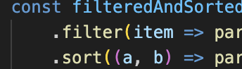
Part 3 >>
Backend - Sort Algorithm
Ranking Api
Need SORT
Expected output
Timsort: O(nlogn)
-> merge sort + insertion sort
Notes:
Javascript's built-in function sort was used. The sort function uses the timsort method with O(nlogn) time complexity, and this alignment is a combination of the advantages of mergesort and the advantages of insertionsort. The advantages of mergesort are stable and efficiently aligned according to data size, and the advantages of insertionsort are very fast when there is little or almost no data. The criteria for small and large amounts of data are divided into 32. 자바스크립트의 내장 함수 sort를 사용하였다. sort 함수는 O(nlogn) 시간복잡도를 가지고 timsort 방식을 사용하고 이 정렬은 mergesort의 장점과 insertionsort의 장점을 합쳐서 만든 정렬이다. mergesort의 장점은 데이터 크기에 따라 안정적이고 효율적으로 정렬하고 insertionsort의 장점은 데이터가 적거나 거의 정렬되어 있는 경우 매우 빠릅니다. 데이터의 적고 많음의 기준은 32개로 나눕니다. O(n)인 counting sort,radix sort는 추가적인 메모리를 사용하고 배열 원소중 가장 큰값에 따라 시간복잡도가 영향을 받는데 우리 데이터는 보통 크기가 큰 숫자(메모리사용량에서)를 정렬하므로 느릴 수 있다. 추가 메모리를 많이 사용하는 경우, 캐시 미스가 증가할 가능성이 크다. 이 또한 성능에 영향을 미친다.

Slide 26

Demo
ⓒSaebyeol Yu. Saebyeol’s PowerPoint

Slide 27
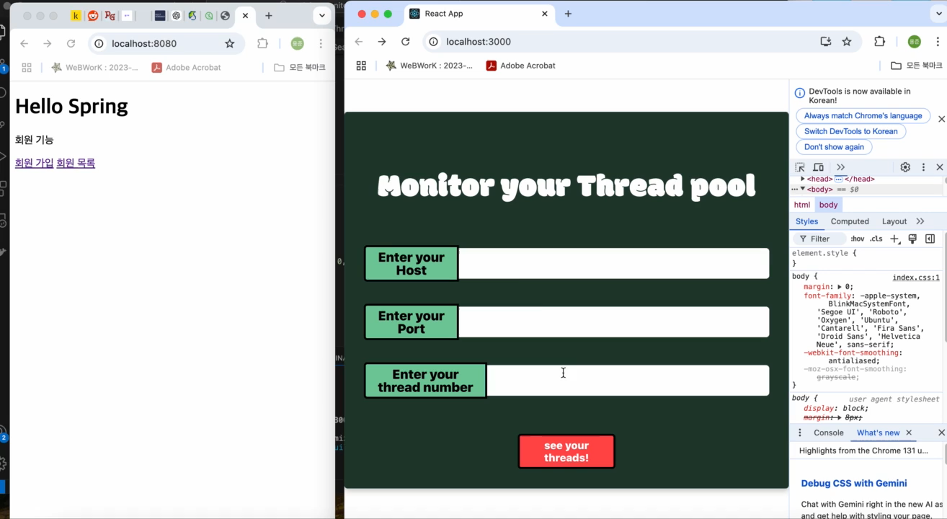

Slide 28

Part 3
Challenges
ⓒSaebyeol Yu. Saebyeol’s PowerPoint

Slide 29
Part 3 >>
Frontend - pagination
response: 10000 data
Backend
Frontend
request : 10000 data

Slide 30
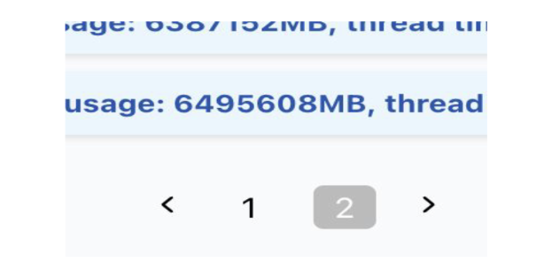
Part 3 >>
Frontend - pagination
Backend

Slide 31
Part 3 >>
Frontend - pagination
response: 10 data
Backend
Frontend
request : first page

Slide 32
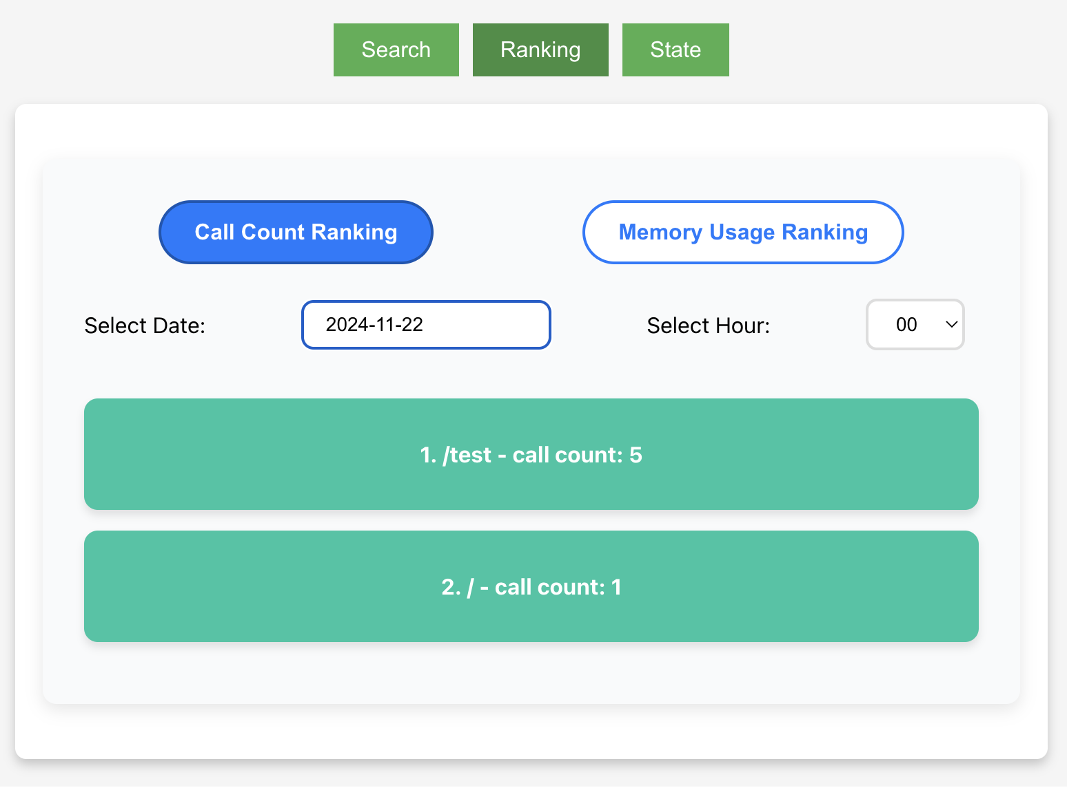
Part 3 >>
Frontend - Handling Date and Time Selection Issues in User Inputs
Backend
Notes:
Initially, the Call Count Ranking page was designed to immediately reflect changes in state whenever the user selected a date or time.
This approach aimed to allow users to easily combine date and time inputs, but it resulted in issues due to the asynchronous nature of React's state updates.

Slide 33
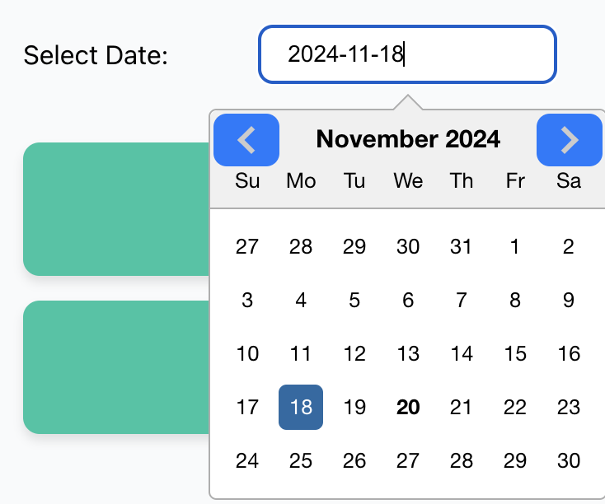
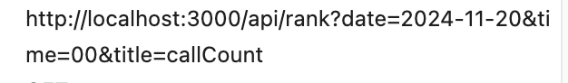
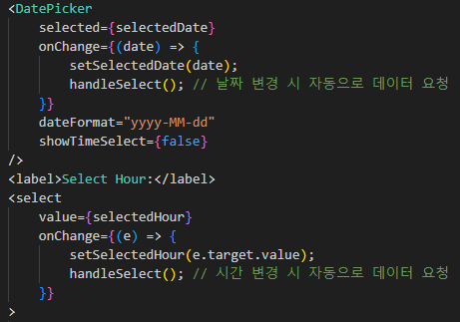
Part 3 >>
Frontend - Handling Date and Time Selection Issues in User Inputs
Backend
Notes:
When users selected a date or time, outdated values were sometimes sent to the API.
This issue arose because React updates state asynchronously.
As a result, when handleSelect was called immediately after a state update, it used the previous state, causing mismatched data in API requests.

Slide 34
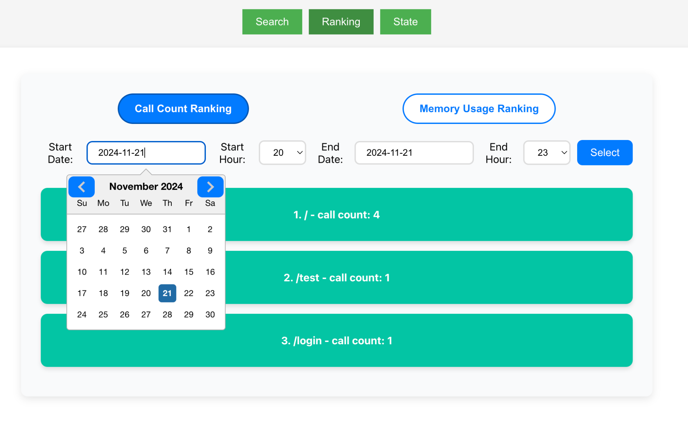
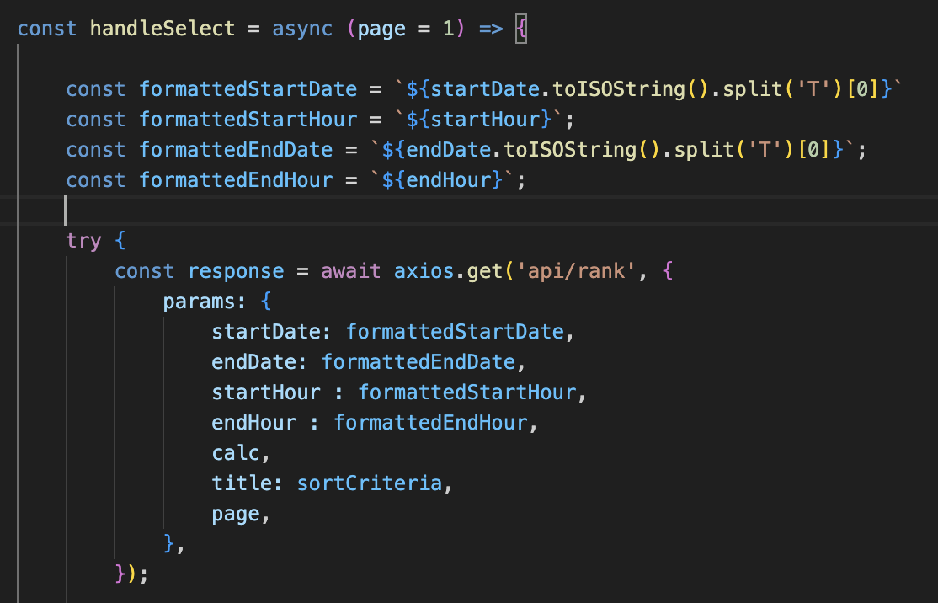
Part 3 >>
Frontend - Handling Date and Time Selection Issues in User Inputs
Backend
Notes:
To resolve the issue, we added a Select button to send API requests only after both date and time are selected.
This approach ensures that the API request is triggered only when the Select button is clicked, using the final state values.
By the time the button is pressed, React completes all state updates, preventing data mismatches and enhancing user reliability.

Slide 35
Part 4
Limitations & Evaluation
ⓒSaebyeol Yu. Saebyeol’s PowerPoint

Slide 36
Part 4 >>
Limitations
Monitoring purpose only
Cannot modify the target project directly
Performance degradation
When reading large amount of data
Status of active threads
Total count of status is extracted BUT blended with basic spring threads
Thus, cannot extract status of every single thread
Notes:
First of, our program aims for monitoring support. Thus, it doesn’t include any function to directly modify the target project we are analyzing.
Next, performance degradation happens when reading large amount of data. Other situations are followed by reasonable delay or degradation.
Lastly, status of active threads cannot be extracted in detail.
Total count of the status can be extracted but are blended with other basic spring threads. Thus per-thread status cannot be extracted.

Slide 37
Part 4 >>
Evaluation for our library
How? : measured response time for 10 sample APIs , repeated 10 times each
Test | Performance Degredation (avg)
Single Request | too small to measure (sometimes slow, sometimes faster)
Load Test (1000 requests in 1 sec) | same as above

Slide 38
Part 4 >>
Evaluation for reading file
How? : measured response time
Test | response time
1000 datas in file | 5 ms
10000 datas in file | 40 ms
100,000 datas in file | 200 ms

Slide 39

Q&A

